Slide 1
GIT and Github session 2
Harshee Pitroda – SURE Trust

Slide 2
The rainbow project
To learn the basics of Git, throughout these series you are going to be working on
the Rainbow project

Slide 3
Repositories

Slide 4
Repositories
On a basic level, a repository is a copy of a Git project.
At first, you will create one local repository called rainbow to work on the Rainbow project
In future we will create a remote repository called rainbow-remote.
And finally, to simulate that you are collaborating with a friend on the Rainbow project, you will create a second local repository called friend-rainbow.

Slide 5
Commits

Slide 6
Commits
In the Rainbow project, you are going to create and edit files to list the colors of the rainbow, and some colors that are not part of the rainbow.
This is not meant to be a realistic example of a project version controlled by Git.
It’s a simplified project that enables you to focus on learning instead of building something complicated
Every time you add a color to the Rainbow project, you are going to make a commit in a repository

Slide 7
Commits
A commit basically represents a version of your project. These commits help me to look at different versions of the project.
In the diagrams, the commit will be represented by a circle in the color you added, and we will use the name of the color as the name of the commit as well.
For example, the first color that you will add to your Rainbow project is red, so the circle that will represent that commit will be colored red, and we will refer to it as the red commit

Slide 8
Commits
Git also allows me to compare any of those commits (or saved versions of my project) to one another to check what changed between the different versions. This illustrates how Git helps me track the history of my project.

Slide 9
Realistic website example
Over the course I will also simulate what it would be like to work on the realistic example
It will only be used to provide further examples and descriptions of how certain features of Git are used.

Slide 10

Git
Git was created by Linus Torvalds to version control the work done on a large software development project called the Linux kernel.

Slide 11
How to interact with a computer
The two main ways to interact with a computer are by using the graphical user interface or the command line.
The graphical user interface (GUI) is the set of graphical representations of objects (icons, buttons, etc.) that allows you to interact with your computer.
The command line—also known as the command line interface (CLI), terminal, or shell—is a place where you can type text-based commands to interact with your computer.
The default way to work with Git is through the command line. However, there are also ways in which you can work with Git using a GUI

Slide 12
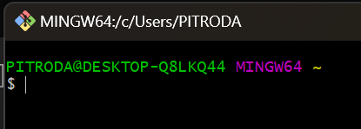






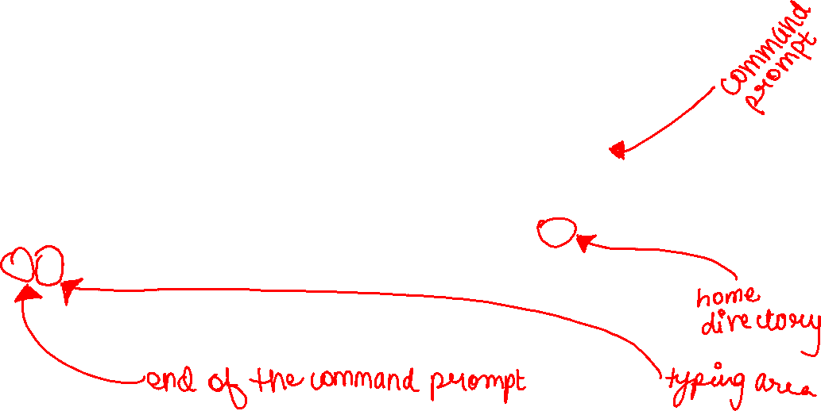






Command Line
When you open a new command line window, the directory location starts off at the current user directory (also known as the home folder), which is represented by the tilde sign (~)

Slide 13
MINGW64 stands for "Minimalist GNU for Windows 64-bit." It is a development environment for Windows that provides a Unix-like terminal and tools, allowing developers to compile and run Unix-based applications on the Windows operating system.

Slide 14
Command Line
The command line application in Windows is Git Bash. It will only be available if you have Git installed on your computer.
Some commands produce output, and some don’t.
The output for Git-related commands does not differ between operating systems.

Slide 15
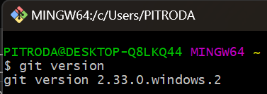
First command
If you have Git installed on your computer, then it will provide the version number that you have installed. If you don’t have Git installed on your computer, then the output will provide you with a message indicating that it is not installed.

Slide 16
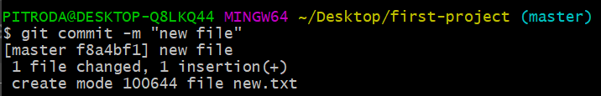
Command Options and Arguments
Sometimes you will use commands with options and/or arguments.
Options are settings that change the behavior of a command. An option follows a single dash (-) or a double dash (--).
Arguments are values that provide information to the command. They will be denoted by angle brackets (<>), and you need to replace them with the actual values you want to use.

Slide 17
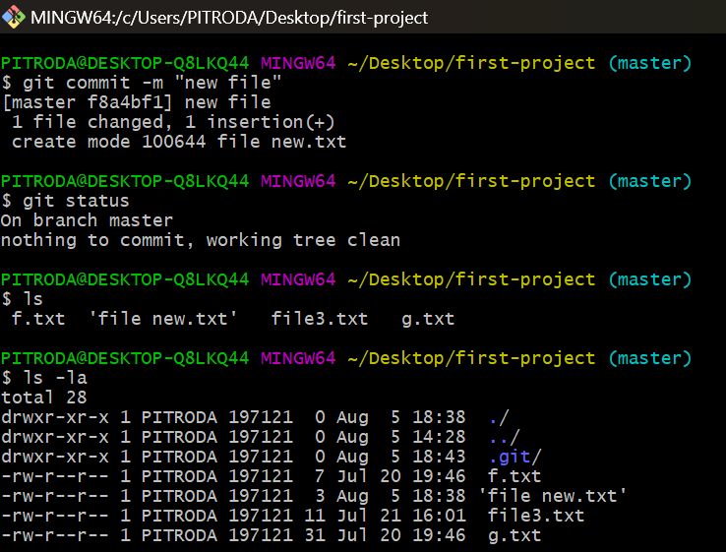
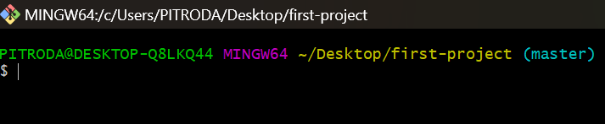
Clearing the Command Line
After you’ve entered a lot of commands, the command line window gets quite cluttered. To clear the contents of the command line window, you can use the clear command.

Slide 18

Working with Directories
When you navigate to other directories in the command line, the command prompt will change to indicate the directory you are in. You can also use the pwd command, which stands for “print working directory,” to see the path to the current directory.

Slide 19




Working with Directories
When you navigate to other directories in the command line, the command prompt will change to indicate the directory you are in. You can also use the pwd command, which stands for “print working directory,” to see the path to the current directory.
Directories in a path are separated by a slash (/).

Slide 20
VIEWING THE CONTENTS OF DIRECTORIES
You can view the contents of a directory in the GUI and the command line window.
There are two types of files and directories that exist in the filesystem:
visible files and directories and
hidden files and directories.
Visible files and directories are always visible in the filesystem.
Hidden files and directories are visible only in the filesystem if you change your settings to view them.
They are often files or directories that store information that we, as users, don’t need to access, such as application configurations and various system settings.

Slide 21
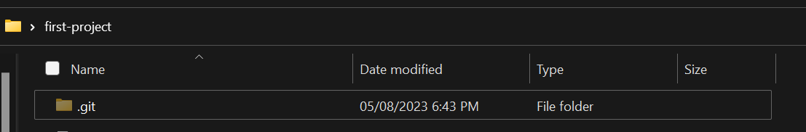


Hidden Files
I do not recommend modifying or deleting hidden files or directories, unless you really know what you’re doing!!!
Once you change your settings to view hidden files and directories, they appear partially transparent (grayed out). Their names often start with a dot (.).

Slide 22
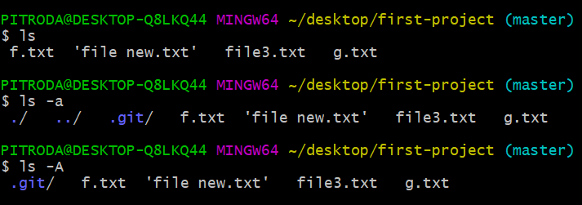
View Hidden Files
In the command line, to view a list of the visible files and directories in the current directory you use the ls command (which stands for “list”).
To view both visible and hidden files and directories in the current directory you use the ls command with the -a option: ls -a.

Slide 23
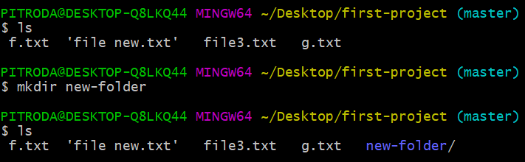
CREATING A DIRECTORY
In the command line, to create a directory you will use a command called mkdir, which stands for “make directory.” The directory will be created inside the current directory when you execute the command.

Slide 24
THANK YOU
Harshee Pitroda

